Slide 1
Angles in a Circle and the Arcs
By Zaylie Collins & Maclaine Ward

Slide 2
A
Minor Arcs: AB, DA
Major Arcs: ADB, DBA
Semicircle: DCB
Diameter: DB
Chord: DB
B
D
E
C

Slide 3
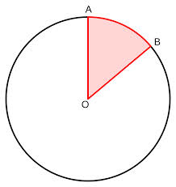
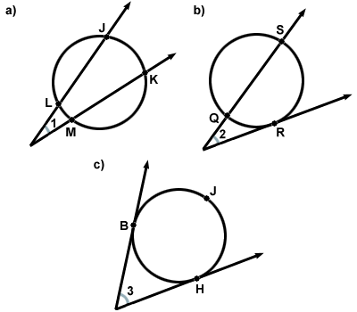
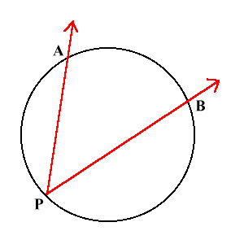
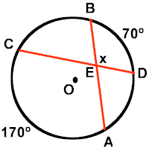
Central Angle: an angle with a vertex at the center
Inscribed Angle: an angle with the vertex at the perimeter
Inside Angles:
  Made from two chords
    Chord: a line segment whose endpoints are on the circle
4. Outside Angles:
  Made from tangent or secant lines

Slide 4
Always Equidistant
Touch exactly ONE spot
The point of tangency
If a line is tangent to a circle, then the line is perpendicular, creating right angles(converse).
TANGENT LINES

Slide 5
SECANT LINES
Yº
Xº
1
M<1= ½ (x-y)
Xº
1
Yº
A line that intersects the circle at two points.
m<1= ½ (x+y)

Slide 6
EXAMPLE PROBLEMS:
D
5. Find aº
1. DE= 110
BC= 64
Find m<A
2. If it is 5:00, what is the measure of the minor arc formed by the hands of an analog clock?
3. Find the length of the darkened arc.
4. Find the length of the darkened arc.
(leave in pi)
B
A
a
C
E
136º
16.4m

Slide 7
PRACTICE PROBLEMS:

